Slide 1
Serological courses could be followed for 26 patients who were initially seronegative and then underwent seroconversion during the observation period

Slide 3
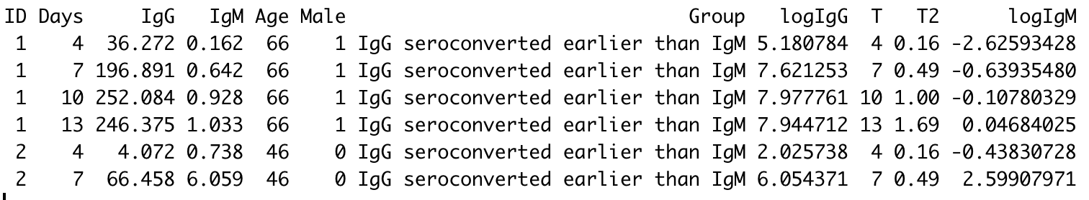

Slide 4
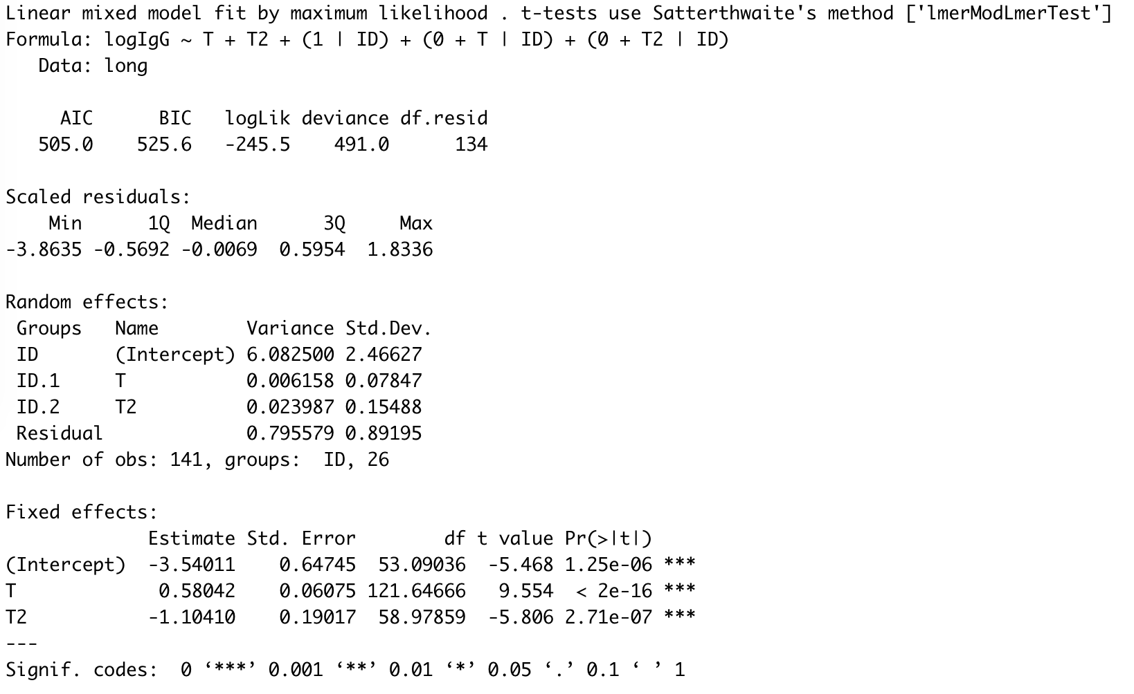

Slide 5
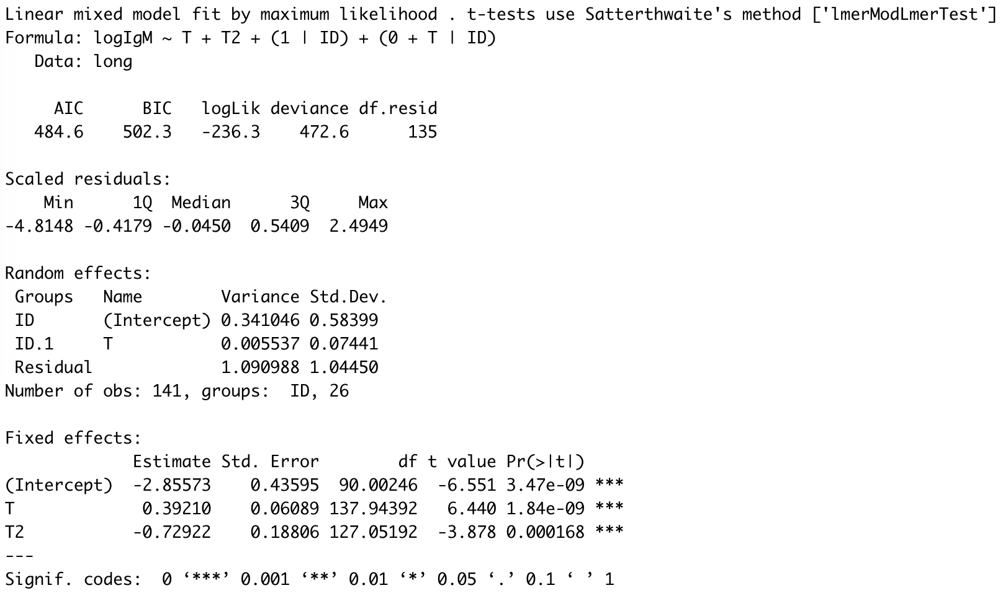

Slide 6
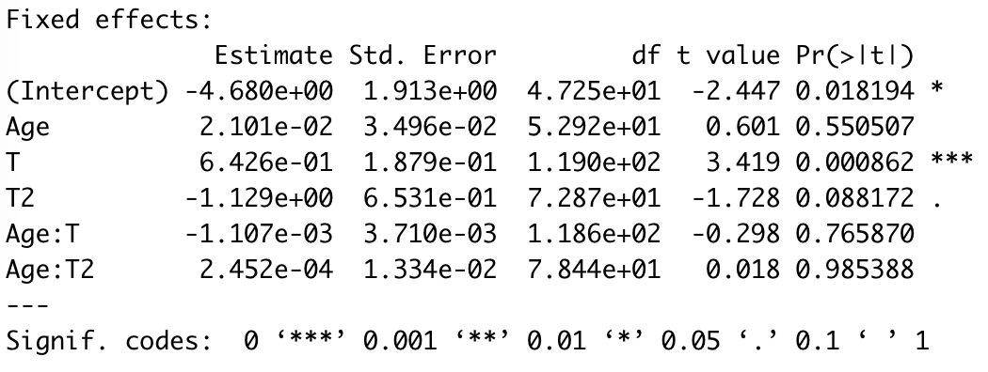
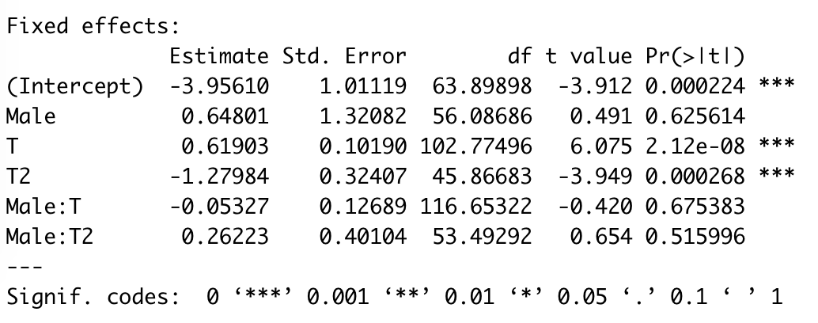
No association with Age & sex
Age & IgG
Sex & IgG

Slide 7
Next?
dIgG/dt= k – m.IgG => IgG(t)=k/m(1-exp(-dt))+IgG₀.exp(-dt)
Ebola model
But lack of longer follow-up to observe the second phase
Everythings on Github: https://github.com/rodthiebaut/Covid19-Long-analysis

